Slide 1
A Study Of The Book Of Revelation
July 25, 2021

Slide 2
Resources used:
A Study Of The Book Of Revelation by Bob Dodson
More Than Conquerors by William Hendriksen
Overcoming With The Lamb, Florida College Annual Lectures, February 7-10, 1994
Outline of the Book of Revelation by John Robertson – Floral Heights Church of Christ https://floralheightschurchofchrist.org/Class%20-%20Bible%20Books/Revelation.pdf
Revelation – An Introduction and Commentary by Homer Hailey
Revelation (Truth Commentaries) by Robert Harkrider
Revelation (A Study Workbook) by Robert Harkrider
Revelation and charts by Donnie Rader
Revelation charts by Keith Greer
Studies In The Book Of Revelation by Ferrell Jenkins
The Apocalypse of St. John by Henry Barclay Swete http://biblicalstudies.gospelstudies.org.uk/pdf/e-books/swete_h-b/apocalypse-of-st-john_swete.pdf (540 pages)
The Old Testament In The Book Of Revelation by Ferrell Jenkins
The Revelation Of St. John The Divine by G.B. Caird
The Book of Revelation by Foy E. Wallace
The Avenging of the Apostles and Prophets by Arthur M. Ogden
Worthy Is The Lamb by Ray Summers
Written exchange on THE DOMITIAN PERSECUTION between Arthur M. Ogden and Ferrell Jenkins presented in Searching The Scriptures, June 12, 1989, pages 7-12

Slide 3
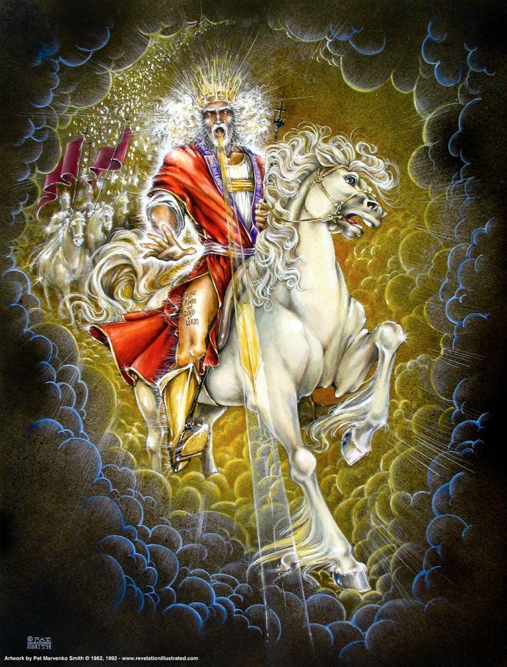
Book of Revelation: Chapter 19
Righteous Judgment of God Praised
The Victorious Christ

Slide 4
Rejoicing of the Saints
Revelation 19
Chapter 18 revealed the destruction of the harlot city Rome and the world’s reaction of sorrow due to a loss of luxurious living and social status.
In contrast with the mourning of the kings, merchants, and those who made their living on the sea was the saints of God. The saints were told to rejoice at the tyrant’s fall (Revelation 18:20).
Chapter 19 expounds upon this rejoicing and reveals the destruction of the beast and the false prophet.
While those who drank Rome’s wine and were intoxicated with her lust, wealth, and worldly status believed she was indestructible the Lord proved her weak and feeble.
Her ways that seemed so appealing and entertaining have now been proved poisonous and deadly.
The saints who abstained from having fellowship with her sins have cause for rejoicing because they were right to reject her pernicious ways (see Revelation 18:4).

Slide 5

Revelation 19:1
Revelation 19
“After these things I heard as it were a great voice of a great multitude in heaven, saying, Hallelujah; Salvation, and glory, and power, belong to our God”

Slide 6
Revelation 19:2
Revelation 19
“for true and righteous are his judgments; for he hath judged the great harlot, her that corrupted the earth with her fornication, and he hath avenged the blood of his servants at her hand.”

Slide 7
Rejoicing of the Saints
Revelation 19
Emperors’ worshippers judged (14:9-12) (cf. Revelation 17:5; 18:20-21).
First “Hallelujah” (“Praise to the Lord”)
“Loud voice of a great multitude” (Sounded like)
Alleluia – “salvation, glory, honor and power belong to the Lord our God”
World mourns – God’s people rejoice!

Slide 8
Rejoicing of the Saints
Revelation 19
“Nowhere else is this word found in the New Testament; however, commencing with Psalm 104, many of the psalms begin and/or end with ‘praise ye the Lord.’ This scene of exultation should not have been separated from the last chapter, for it reveals a sharp contrast with the kings, merchants, and shipmen who mourn over the downfall of the harlot. John hears praise of God coming from heaven four times (19:1, 3, 4, 6).” (Robert Harkrider, Revelation, Truth Commentaries, page 277)

Slide 9
Rejoicing of the Saints
Revelation 19
God’s judgments are true and righteous
He judged the great harlot that had corrupted the earth with her fornication
He has avenged the blood of His servants
Vindication has now been achieved!
Triumph of righteousness over evil
Calm certainty knowing God can conquer and judge His enemies

Slide 10
Rejoicing of the Saints
Revelation 19
Condemnation of the Beast and Worshippers
God’s judgments are true and righteous
He judged the great harlot that had corrupted the earth with her fornication
He has avenged the blood of His servants
Vindication has now been achieved!
Triumph of righteousness over evil
Their future in the spiritual realm is eternal life
Their smoke rising up for ever and ever, eternal punishment (14:9-11; 20:10; Matthew 25:46).

Slide 11
Revelation 19:3
Revelation 19
“And a second time they say, Hallelujah. And her smoke goeth up for ever and ever.”
Revelation 14:9-11

Slide 12
Revelation 19:4
Revelation 19
Last time we have these. Revelation 4:4; 5:6, 11ff; 7:11; 14:3
“And the four and twenty elders and the four living creatures fell down and worshipped God that sitteth on the throne, saying, Amen; Hallelujah.”

Slide 13
Rejoicing of Heavenly Host
Revelation 19
Multitude in heaven continue to rejoice
Second and third Hallelujah
The martyrs know now that their future is now eternal life
Beast, those who worshipped her, have torment with fire forever!
Rome will not be resurrected!
Heavenly host, closet to God, bowed their head in total agreement in the chorus of praise.

Slide 14
Revelation 19:5
Revelation 19
Revelation 18:20.
“And a voice came forth from the throne, saying, Give praise to our God, all ye his servants, ye that fear him, the small and the great.”

Slide 15
Voice From the Throne
Revelation 19
Voice not identified but it emanates from the throne
All are summoned to give praise to God
God alone is worshipped in the Apocalypse
The elders, the living creatures, and all of His servants ascribe Him praise
Deliverance of the church from her enemies
Even during the persecutions – God is firmly in control – never forget!

Slide 16
Revelation 19:6
Revelation 19
“And I heard as it were the voice of a great multitude, and as the voice of many waters, and as the voice of mighty thunders, saying, Hallelujah: for the Lord our God, the Almighty reigneth.”
The word means “the all-ruling” (Strong’s)

Slide 17
Revelation 19:7
Revelation 19
“Let us rejoice and be exceeding glad, and let us give the glory unto him: for the marriage of the Lamb is come, and his wife hath made herself ready.”

Slide 18
Revelation 19:8
Revelation 19
“And it was given unto her that she should array herself in fine linen, bright (and) pure: for the fine linen is the righteous acts of the saints.”

Slide 19
Revelation 19:9
Revelation 19
“And he saith unto me, Write, Blessed are they that are bidden to the marriage supper of the Lamb. And he saith unto me, These are true words of God.”

Slide 20
Revelation 19:10
Revelation 19
“And I fell down before his feet to worship him. And he saith unto me, See thou do it not: I am a fellow-servant with thee and with thy brethren that hold the testimony of Jesus: worship God; for the testimony of Jesus is the spirit of prophecy.”

Slide 21
Fourth Hallelujah
Revelation 19
Fourth Hallelujah
Thunderous response
Powerful, attention-getting voice
Voice of large crowd, roar of a great waterfall, and rolling of heavy thunder
Sounds the praise of the sovereign Lord
Reigns – defeated the harlot – assurance of victory!
His omnipotence demonstrated that His kingdom stands and men’s fall! – 11:15

Slide 22
Marriage of the Lamb
Revelation 19
The Lord’s people (Isaiah 50:1; 54:5; 57:3ff; Ezekiel 16:1ff; Hosea 9:1) and the church of Jesus Christ (Romans 7:4;) are often portrayed in scriptures as the Lord’s wife.
Here however, the climatic scene of the whole Apocalypse is now at hand – Lamb and the bride!
Wedding feast … cf. 2 Corinthians 11:2; Ephesians 5:22ff
“Wife made herself ready”
“She would be clothed in fine linen”
“Clean and bright”
How? Her faithfulness to the Lamb and the “righteous acts of the saints.”

